Slide 1
Expression Tress

Slide 2
A Binary Expression Tree is . . .
A special kind of binary tree in which:
1. Each leaf node contains a single operand
2. Each nonleaf node contains a single binary operator
3. The left and right subtrees of an operator node represent subexpressions that must be evaluated before applying the operator at the root of the subtree.

Slide 3
A Four-Level Binary Expression
‘*’
‘-’
‘/’
‘8’
‘5’
‘+’
‘3’
‘4’
‘2’

Slide 4
Levels Indicate Precedence
The levels of the nodes in the tree indicate their relative precedence of evaluation (we do not need parentheses to indicate precedence).
Operations at higher levels of the tree are evaluated later than those below them.
The operation at the root is always the last operation performed.

Slide 5
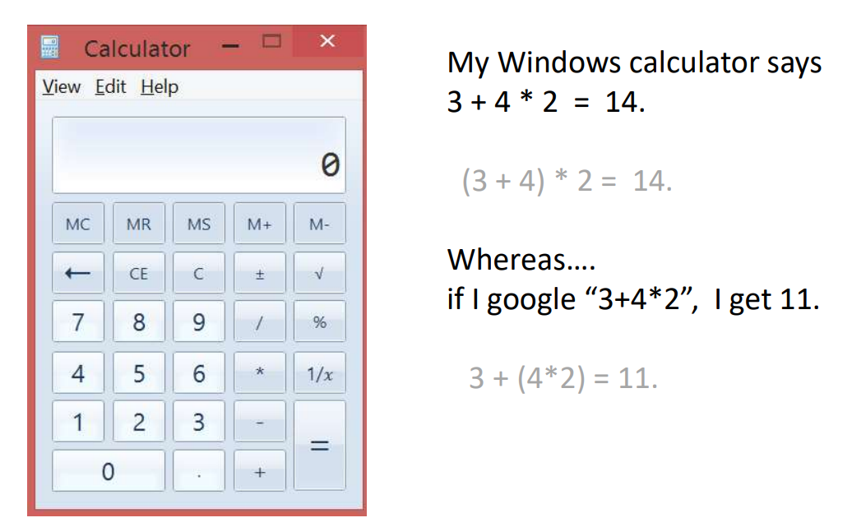
Old calculator

Slide 6
A Binary Expression Tree
‘*’
‘+’
‘3’
‘4’
‘2’
What value does it have?
( 4 + 2 ) * 3 = 18

Slide 7
Easy to generate the infix, prefix, postfix expressions (how?)
‘*’
‘-’
‘/’
‘8’
‘5’
‘+’
‘3’
‘4’
‘2’
Infix: ( ( 8 - 5 ) * ( ( 4 + 2 ) / 3 ) )
Prefix: * - 8 5 / + 4 2 3
Postfix: 8 5 - 4 2 + 3 / *

Slide 8
Inorder Traversal: (A + H) / (M - Y)
Print second
tree
‘/’
‘+’
‘-’
‘A’
‘H’
‘M’
‘Y’
Print left subtree first
Print right subtree last

Slide 9
Preorder Traversal: / + A H - M Y
Print first
tree
‘/’
‘+’
‘-’
‘A’
‘H’
‘M’
‘Y’
Print left subtree second
Print right subtree last

Slide 10
Postorder Traversal: A H + M Y - /
Print last
tree
‘/’
‘+’
‘-’
‘A’
‘H’
‘M’
‘Y’
Print left subtree first
Print right subtree second

Slide 11
Construction of Expression Tree
Let us consider a postfix expression is given as an input for constructing an expression tree. Following are the step to construct an expression tree:
Read one symbol at a time from the postfix expression.
Check if the symbol is an operand or operator.
If the symbol is an operand, create a one node tree and push a pointer onto a stack
If the symbol is an operator, pop two pointers from the stack namely T₁ & T₂ and form a new tree with root as the operator, T₁ & T₂ as a left and right child
A pointer to this new tree is pushed onto the stack
Thus, An expression is created or constructed by reading the symbols or numbers from the left. If operand, create a node. If operator, create a tree with operator as root and two pointers to left and right subtree

Slide 12
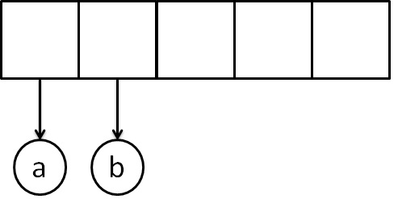
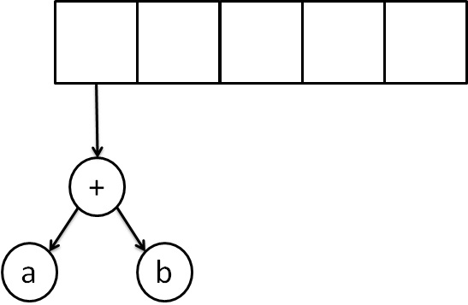
Example - Postfix Expression Construction
a b + c *
The first two symbols are operands, we create one-node tree and push a pointer to them onto the stack.
Next, read a'+' symbol, so two pointers to tree are popped,a new tree is formed and push a pointer to it onto the stack.

Slide 13
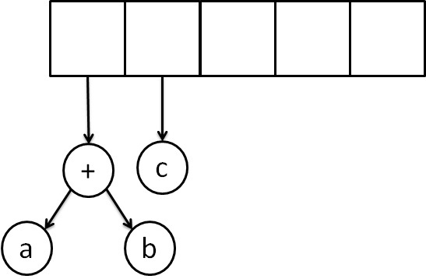
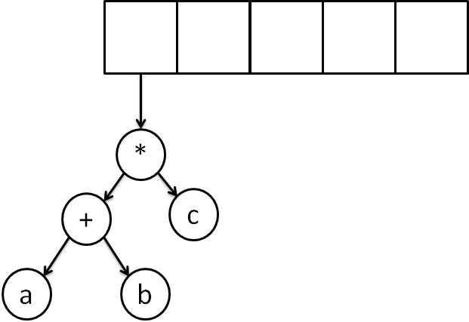
Example - Postfix Expression Construction/ evaluate a postfix expression
Next, 'c' is read, we create one node tree and push a pointer to it onto the stack.
Finally, the last symbol is read ' * ', we pop two tree pointers and form a new tree with a, ' * ' as root, and a pointer to the final tree remains on the stack.

Slide 14
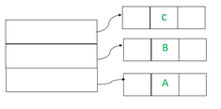
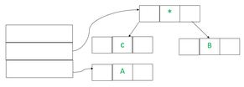
Examples:
The first three symbols are operands, so create tree nodes and push pointers to them onto a stack as shown below.
Input : A + B * C / D
Postfix : A B C*+ D/
In the Next step, an operator ‘*’ will going read, so two pointers to trees are popped, a new tree is formed and a pointer to it is pushed onto the stack
In the Next step, an operator ‘+’ will read, so two pointers to trees are popped, a new tree is formed and a pointer to it is pushed onto the stack.

Slide 15
Constructed Expression Tree
class ExpressionTree:
def inorder(self, x):
if not x:
return
self.inorder(x.left)
print(x.value, end=" ")
self.inorder(x.right)
def main():
s = "ABC*+D/"
stack = Stack()
tree = ExpressionTree()
for c in s:
if c in "+-*/^":
z = Node(c)
x = stack.pop()
y = stack.pop()
z.left = y
z.right = x
stack.push(z)
else:
stack.push(Node(c))
print("The Inorder Traversal of Expression Tree: ", end="")
tree.inorder(stack.pop())
if __name__ == "__main__":
main()
class Node:
def __init__(self, value=None, left=None, right=None, next=None):
self.value = value
self.left = left
self.right = right
self.next = next
class Stack:
def __init__(self):
self.head = None
def push(self, node):
if not self.head:
self.head = node
else:
node.next = self.head
self.head = node
def pop(self):
if self.head:
popped = self.head
self.head = self.head.next
return popped
else:
raise Exception("Stack is empty")

Slide 16
Threaded Binary Trees

Slide 17
Threaded Binary Trees
Two many null pointers in current representation of binary trees n: number of nodes number of non-null links: n-1 total links: 2n null links: 2n-(n-1)=n+1
Replace these null pointers with some useful “threads”.

Slide 18
Threaded Binary Trees (Continued)
A Threaded Binary Tree is one of the variants of a normal Binary Tree that assists faster tree traversal and doesn't need a Stack or Recursion.
It reduces memory wastage by placing the null pointers of a leaf node to the in-order successor or in-order predecessor.
It decreases the memory wastage by setting the null pointers of a leaf node to the in-order predecessor or in-order successor.

Slide 19
Threaded Binary Trees (Continued)
If ptr->left_child is null,
replace it with a pointer to the node that would be
visited before ptr in an inorder traversal
If ptr->right_child is null,
replace it with a pointer to the node that would be
visited after ptr in an inorder traversal
inorder predecessor
inorder successor

Slide 20
A Threaded Binary Tree
root
A
dangling
B
C
dangling
D
E
F
G
inorder traversal:
H, D, I, B, E, A, F, C, G
H
I

Slide 21
Memory Representation of A Threaded BT
root
--
f
f
f
A
f
f
B
f
f
C
f
f
D
f
t
E
t
t
F
t
t
G
t
t
H
t
t
I
t

Slide 22
Threaded Binary Trees
Advantages of Threaded Binary Tree
It eliminates the use of stack as it perform linear traversal, so save memory.
Enables to find parent node without explicit use of parent pointer
Threaded tree give forward and backward traversal of nodes by in-order fashion
Nodes contain pointers to in-order predecessor and successor
For a given node, we can easily find inorder predecessor and successor. So, searching is much more easier.
In threaded binary tree there is no NULL pointer present. Hence memory wastage in occupying NULL links is avoided.
The threads are pointing to successor and predecessor nodes. This makes us to obtain predecessor and successor node of any node quickly.
There is no need of stack while traversing the tree, because using thread links we can reach to previously visited nodes.

Slide 23
Threaded Binary Trees
Disadvantages of Threaded Binary Tree
Every node in threaded binary tree need extra information(extra memory) to indicate whether its left or right node indicated its child nodes or its inorder predecessor or successor.
Insertion and deletion are way more complex and time consuming than the normal one since both threads and ordinary links need to be maintained.
Implementing threads for every possible node is complicated.
Increased complexity: Implementing a threaded binary tree requires more complex algorithms and data structures than a regular binary tree. This can make the code harder to read and debug.
Extra memory usage: In some cases, the additional pointers used to thread the tree can use up more memory than a regular binary tree. This is especially true if the tree is not fully balanced, as threading a skewed tree can result in a large number of additional pointers.
Limited flexibility: Threaded binary trees are specialized data structures that are optimized for specific types of traversal.
Difficulty in parallelizing: It can be challenging to parallelize operations on a threaded binary tree, as the threading can introduce data dependencies that make it difficult to process nodes independently. This can limit the performance gains that can be achieved through parallelism.

Slide 24
Threaded Binary Trees
Applications of threaded binary tree –
Expression evaluation: Threaded binary trees can be used to evaluate arithmetic expressions in a way that avoids recursion or a stack. The tree can be constructed from the input expression, and then traversed in-order or pre-order to perform the evaluation.
Database indexing: In a database, threaded binary trees can be used to index data based on a specific field (e.g. last name). The tree can be constructed with the indexed values as keys, and then traversed in-order to retrieve the data in sorted order.
Disk-based data structures: Threaded binary trees can be used in disk-based data structures (e.g. B-trees) to improve performance. By threading the tree, it can be traversed in a way that minimizes disk seeks and improves locality of reference.
Navigation of hierarchical data: In certain applications, threaded binary trees can be used to navigate hierarchical data structures, such as file systems or web site directories. The tree can be constructed from the hierarchical data, and then traversed in-order or pre-order to efficiently access the data in a specific order.

Slide 25
Inorder Traversal using Threads
// Utility function to find leftmost node in a tree rooted
// with n
struct Node* leftMost(struct Node* n)
{
if (n == NULL)
return NULL;
while (n->left != NULL)
n = n->left;
return n;
}
// C code to do inorder traversal in a threaded binary tree
void inOrder(struct Node* root)
{
struct Node* cur = leftMost(root);
while (cur != NULL) {
printf("%d ", cur->data);
// If this node is a thread node, then go to
// inorder successor
if (cur->rightThread)
cur = cur->right;
else // Else go to the leftmost child in right
// subtree
cur = leftmost(cur->right);
}
}
# Utility function to find leftmost Node in a tree rooted
# with n
def leftMost(n):
if (n == None):
return None;
while (n.left != None):
n = n.left;
return n;
# C code to do inorder traversal in a threaded binary tree
def inOrder(root):
cur = leftMost(root);
while (cur != None):
print(cur.data," ");
# If this Node is a thread Node, then go to
# inorder successor
if (cur.rightThread):
cur = cur.right;
else: # Else go to the leftmost child in right
# subtree
cur = leftmost(cur.right);

Slide 26
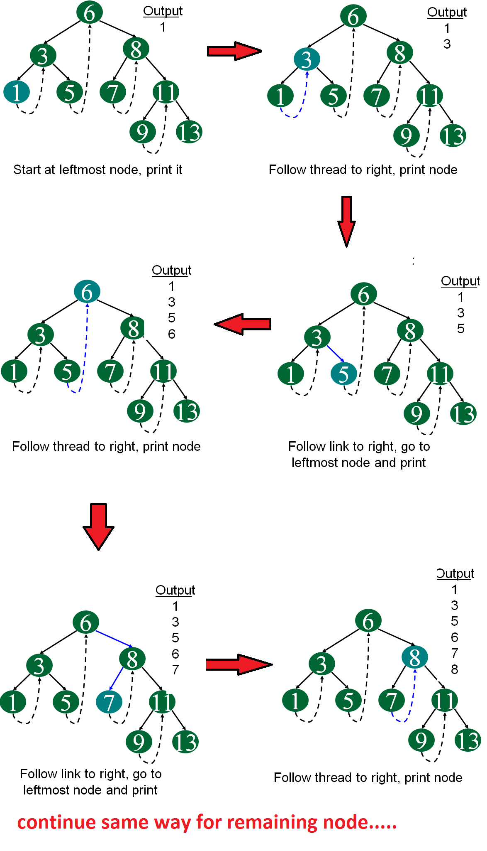
Following diagram demonstrates inorder order traversal using threads.

Slide 27
Any questions ?

